Slide 1
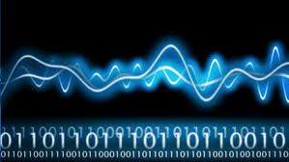

TON DUC THANG UNIVERSITY
FACULTY OF ELECTRICAL AND ELECTRONICS ENGINEERING
402084 DIGITAL IMAGE PROCESSING
CHAPTER 4: DIGITAL IMAGE FILTER
Vu Anh. Le, Phd.

Slide 2
OBJECTIVES
Known DFT and the relation to continuous Fourier transform
Know 2D convolution, circular convolution
Understand 2D filters: low-pass, high-pass, derivative (sobel)
Understand the magnitude of the gradient and edge enhancement.

Slide 3
CHAPTER 4: DIGITAL IMAGE FILTER
1.1 DIGITAL FILTER IN SPATIAL DOMAIN
1.2 DIGITAL FILTER IN FREQUENCE DOMAIN

Slide 4
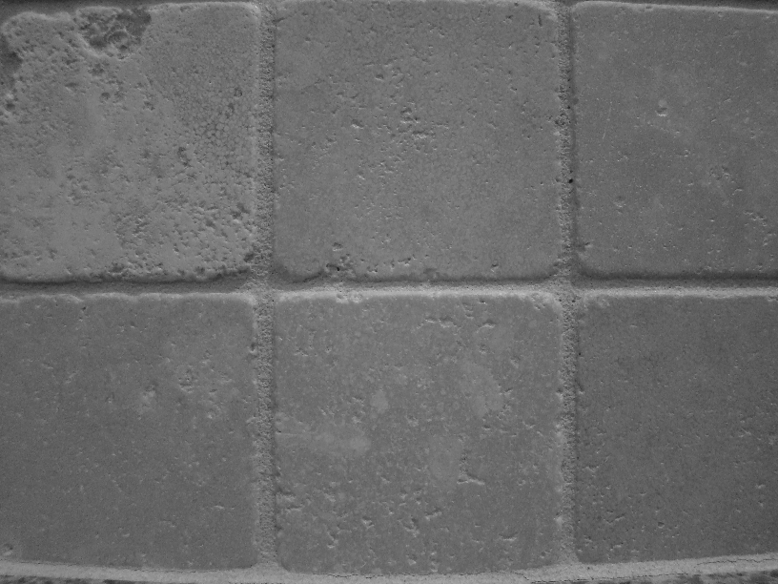
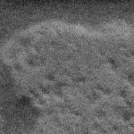
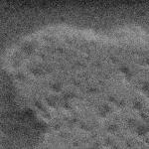

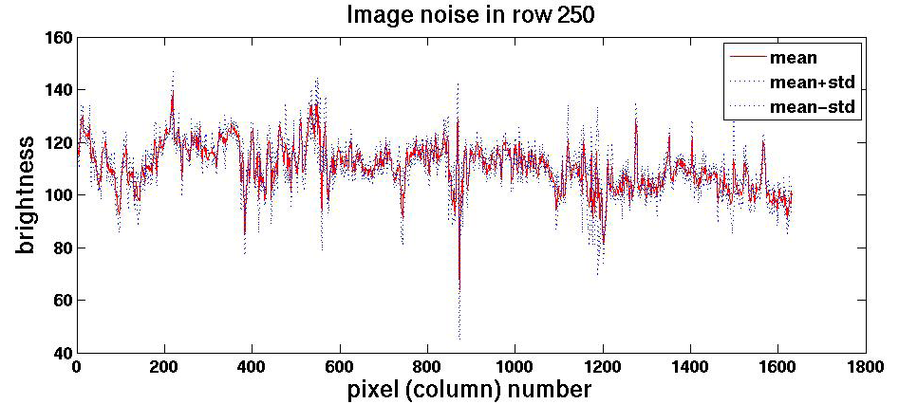
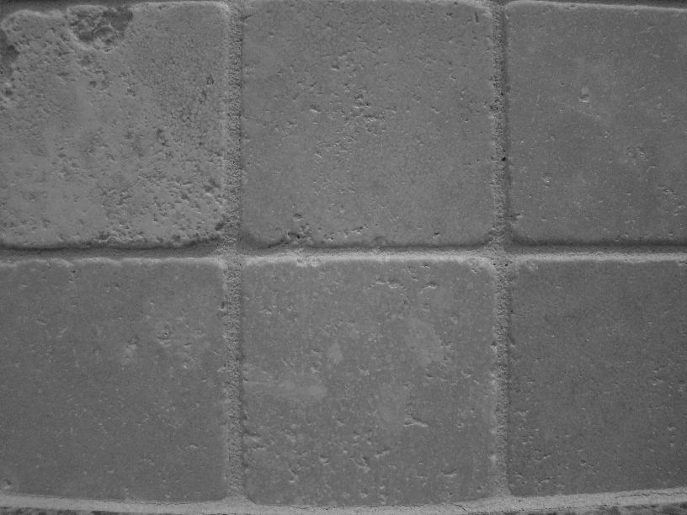
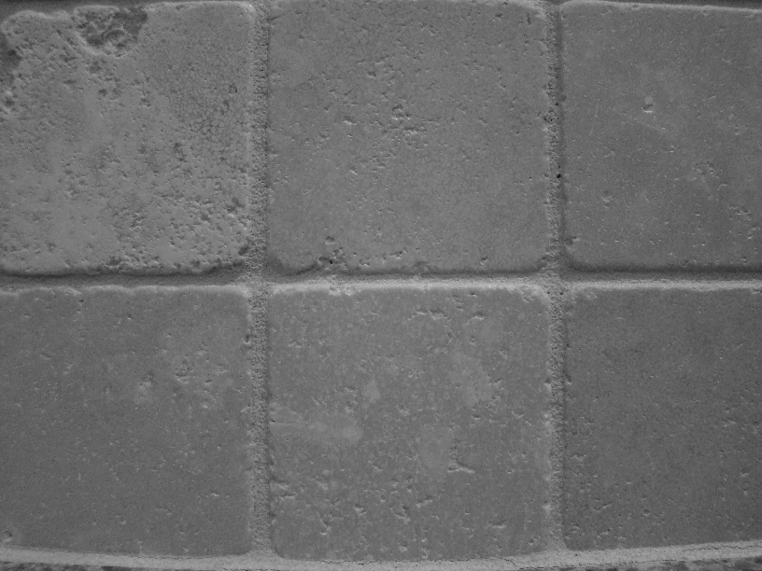


Digital image filter in spatial domain
We can measure noise in multiple images of the same static scene.
How could we reduce the noise, i.e., give an estimate of the true intensities?

Slide 5
Digital image filter in spatial domain
Some important noise model and their use in practice
Gaussian noise: Easy to use mathematically. Therefore often used in practice even if the model is not perfect. Electronic circuit noise and sensor noise due to poor illumination or high temperature.
Rayleigh noise: Occurs in range imaging. Can model skewed histograms.
Gamma and Exponential noise: Occurs in laser imaging. Can be used for approximating skewed histograms.

Slide 6
Digital image filter in spatial domain
Some important noise model and their use in practice (cont)
Uniform noise: Not so practical, but can be useful in random number generation in simulations.
Salt-and-pepper (impulse) noise: Quick transients due to as faulty switching during imaging
Periodic noise: Electrical or electromechanical interference during image acquisition, Newspaper printing

Slide 7
Digital image filter in spatial domain
Some important noise model

Slide 8
Digital image filter in spatial domain
A simple image with different noise

Slide 9
Digital image filter in spatial domain
A simple image with different noise

Slide 10
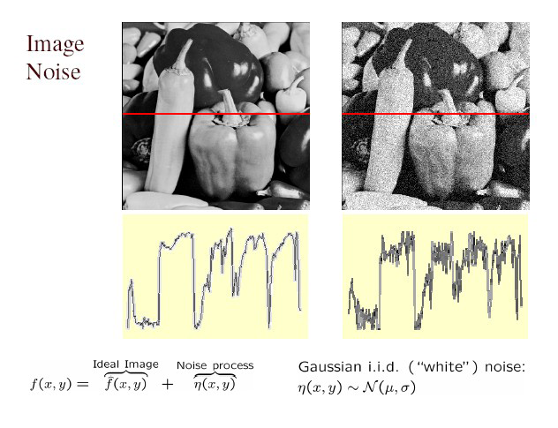
Digital image filter in spatial domain
Noise types:
Gaussian noise: variations in intensity drawn from a Gaussian normal distribution

Slide 11
Digital image filter in spatial domain
Another equation for the Fourier transform of the impulse train sampled signal

Slide 12
Digital image filter in spatial domain
DFT (Discrete Fourier transform),symmetric

Slide 13
Digital image filter in spatial domain
Continuous Fourier transform & DFT

Slide 14
Digital image filter in spatial domain
DFT (Discrete Fourier transform),symmetric and normal

Slide 15
Digital image filter in spatial domain
2D DFT

Slide 16
Digital image filter in spatial domain
1D continuous and discrete convolution

Slide 17
Digital image filter in spatial domain
1D discrete convolution

Slide 18
Digital image filter in spatial domain
2D discrete convolution

Slide 19
Digital image filter in spatial domain
Which Fourier transform has this filter?
Put dirac impulses at every value in the filter, Set the sample distance to . This gives:
Compute the continuous Fourier transform:

Slide 20
Digital image filter in spatial domain
Alternative. Compute the DFT of the filter:
Take the DFT formula:
And insert the filter values:

Slide 21
Digital image filter in spatial domain
A 1D discrete weighted averaging filter is also a low-pass filter

Slide 22
Digital image filter in spatial domain
Low-pass filter in the x- (u-) direction

Slide 23
Digital image filter in spatial domain
Low-pass filter in the y- (v-) direction

Slide 24
Digital image filter in spatial domain
Low-pass filter in the x- (u-) direction and the y- (v-) direction

Slide 25
Digital image filter in spatial domain
A 3x3 averaging filter and a 3x33 weighted averaging filter
A averaging filter be divide by the sum of the values of its coefficients.
The averaging filter have relatives of size 5x5, 7x7…have a sinc×sinc-like Fourier transform.

Slide 26
Digital image filter in spatial domain
Smoothing with averaging
Noise is attenuated. Details and edges are blurred.
The smoothing is not symmetric in all directions, the sinc×sinc-like Fourier transform is not the best choice.

Slide 27
Digital image filter in spatial domain
Image size after 2D linear discrete convolution

Slide 28
Digital image filter in spatial domain
More low-pass filter in the x- (u-) direction and the y- (v-) direction

Slide 29
Digital image filter in spatial domain
Low-pass filtering in the spatial domain

Slide 30
Digital image filter in spatial domain
Computational complexity for discrete convolution

Slide 31
Digital image filter in spatial domain
Computational complexity with and without separation

Slide 32
Digital image filter in spatial domain
First and second derivatives of a 1-D digital function

Slide 33
Digital image filter in spatial domain
Construction of a Laplace filter

Slide 34
Digital image filter in spatial domain
Laplace filtering gives a shaper image

Slide 35
Digital image filter in spatial domain
A normal approximate Laplace filter mask = a high-pass filter

Slide 36
Digital image filter in spatial domain
Low- and High-pass filtering

Slide 37
Digital image filter in spatial domain
Derivative filter plus low-pass in the x- (u-) direction

Slide 38
Digital image filter in spatial domain
Derivative filter plus low-pass in the y- (v-) direction

Slide 39
Digital image filter in spatial domain
Derivative filter in the x- (u-) direction plus low-pass filter in both directions

Slide 40
Digital image filter in frequency domain
Derivative filter in the y- (v-) direction plus low-pass filter in both directions

Slide 41
Digital image filter in frequency domain
Derivative filtering

Slide 42
Digital image filter in spatial domain
The magnitude of the gradient enhances edges in the image

Slide 43
Digital image filter in spatial domain
Derivative filtering and edge enhancement

Slide 44
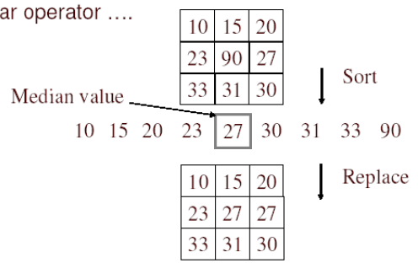
Digital image filter in spatial domain
Non-linear filter: Median filter
No new pixel values introduced
Removes spikes: good for impulse, salt & pepper

Slide 45
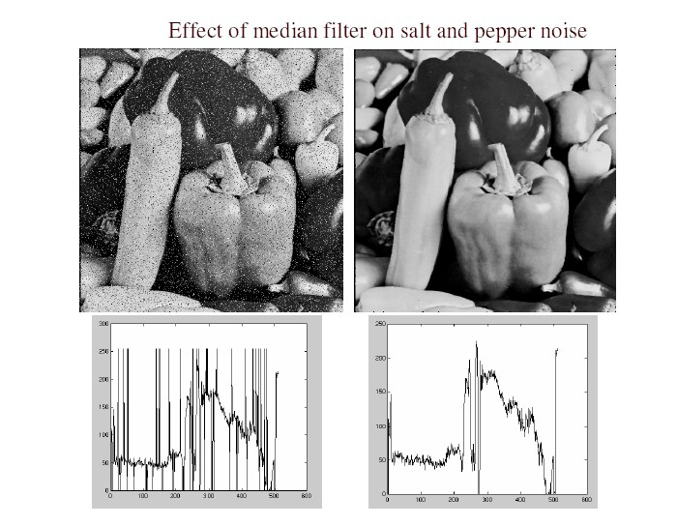
Digital image filter in spatial domain
Non-linear filter: Median filter
Salt and pepper noise
Median filtered
Plots of a row of the image

Slide 46
CHAPTER 4: DIGITAL IMAGE FILTER
1.1 DIGITAL FILTER IN SPATIAL DOMAIN
1.2 DIGITAL FILTER IN FREQUENCE DOMAIN

Slide 47
Digital image filter in frequency domain
Low-pass filtering in Fourier domain

Slide 48
Digital image filter in frequency domain
Gaussian low-pass filters (GLPF)designed in the Fourier Domain
Spatial filter they approximates Gauss functions.
Gaussian low-pass filters can also be designed directly in the Fourier domain.

Slide 49
Digital image filter in frequency domain
Gaussian low-pass filters (GLPF)designed in the Fourier Domain

Slide 50
Digital image filter in frequency domain
Smoothing with GLPF filters

Slide 51
Digital image filter in frequency domain
Ideal low-pass filters (ILPF)designed in the Fourier Domain

Slide 52
Digital image filter in frequency domain
Smoothing with ILPF filters

Slide 53
SAMPLING AND QUANTIZION
Examples of images without and with aliasing

Slide 54
SAMPLING AND QUANTIZION
The Fourier transforms of the images in the previous slide

Slide 55
SUMMARY
In this chapter we have learn:
DFT and the relation to continuous Fourier transform
2D convolution, circular convolution
2D filters: low-pass, high-pass, derivative (sobel)
The magnitude of the gradient and edge enhancement.

Slide 56
HOMEWORK
Review the chapter 4
Read chapter 5 (pp. 166-187 )
Solve the exercise: 4.1, 4.2, 4.3, 4.5, 4.8, 4.11, 4.14, 4.15, 4.20, 4.22.

